Slide 1
DEPARTMENT OF ELECTRONICS AND COMMUNICATION ENGINEERING
Academic Year 2024-2025 (EVEN SEM)
c
ECB1223 – MICROCONTROLLER AND INTERFACING

Slide 2
c
ROVER BASED COURIER DELIVERY VEHICLE
Team members Guide Name
ABHISHEK KUMAR V – 927623BEC001 Dr.K.KARTHIKEYAN
ABSAL K A – 927623BEC004 Ms.SENTHAMIL SELVI
AJIN R – 927623BEC005
DHARINEESH P V – 927623BEC031

Slide 3
c
Introduction
A Rover-Based Courier Delivery Vehicle is a small, wheeled machine that helps deliver things like parcels or food. It can move by itself on a set path or be controlled from a distance. This robot makes delivery easier because it does not need a person to carry the items. It is helpful for sending things over short distances, saving time and effort.

Slide 4
Problem Statement
c
Traditional courier delivery systems face challenges like traffic delays, high labor costs, and limited efficiency. There is a need for an autonomous solution that can deliver packages quickly, safely, and cost-effectively. A rover-based courier delivery vehicle can address these issues by using a small, self-driving robot to perform last-mile deliveries with minimal human involvement.

Slide 5
Objectives
c
The objective of this project is to create a small, self-driving rover that can deliver packages without human help.
It should move safely on roads or paths and avoid obstacles.
The rover will take packages to the correct address in a secure way.
This will help make deliveries faster, safer, and more reliable. The system aims to reduce human effort and improve delivery services.

Slide 6
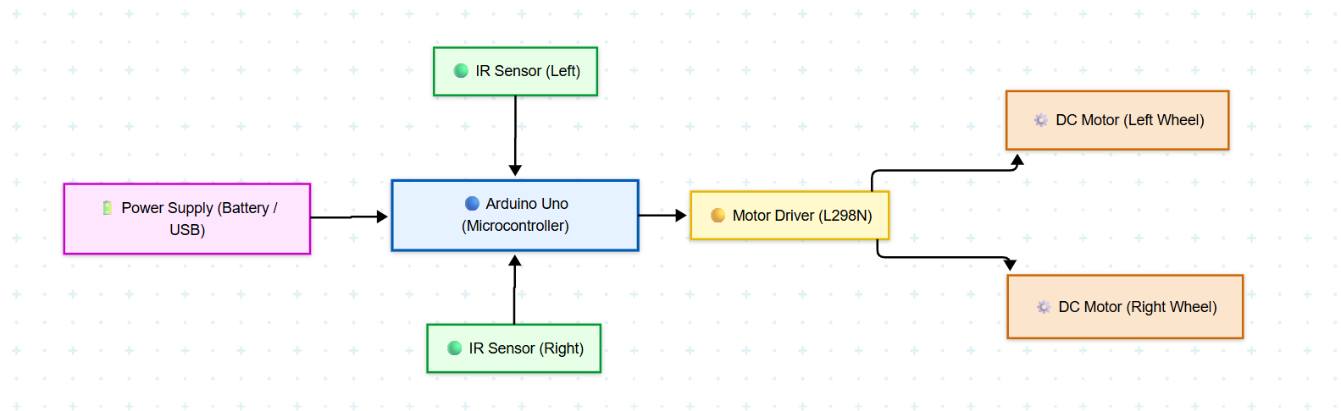
c
Block Diagram

Slide 7
Existing System
c
The current courier delivery system mostly depends on human delivery agents using bikes, vans, or on foot.
These methods can be slow due to traffic, weather, or road conditions.
Deliveries often require human interaction, which can lead to delays or errors.
It also increases fuel costs and labor expenses. There is limited automation, making the process less efficient and harder to scale.

Slide 8
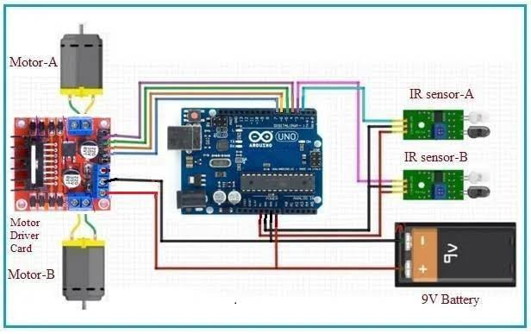
Circuit Diagram/Simulation
c

Slide 9
Componentns
c
Components | Cost (Rs.)
Arduino Board | 250
Motors (4) | 360
IR Sensor | 30
Battery | 300
Motor Driver Card | 350
Jumper wires | 50

Slide 10
Conclusion
Circuit Diagram/Simulation
A rover-based courier delivery vehicle offers a smart solution to modern delivery challenges. It can reduce human effort, cut delivery time, and lower costs. With features like obstacle detection and autonomous navigation, it ensures safe and contactless delivery. This system can improve last-mile logistics, especially in urban and campus areas. Overall, it brings efficiency, safety, and innovation to courier services.

Slide 11
References
c
1. Kumar, A., & Singh, R. (2020). "Design and Implementation of an Arduino
Based Rover based courier delivery vehicle for Package Delivery.“
International Journal of Robotics Research and Development, 8(2), 45–53.
2. Patel, S., & Desai, V. (2019). "Autonomous Delivery Robots for Last-Mile
Logistics: A Review." Journal of Automation and Smart Systems, 11(4), 210–
220.
3. Chen, L., & Wang, J. (2018). "Rover based courier delivery vehicle with
Obstacle Avoidance for Indoor Courier Delivery." Proceedings of the IEEE
International Conference on Robotics and Automation, 3456–3461.

Slide 12
c
References
3. Chen, L., & Wang, J. (2018). "Rover based courier delivery vehicle with
Obstacle Avoidance for Indoor Courier Delivery." Proceedings of the IEEE
International Conference on Robotics and Automation, 3456–3461.
4. Gupta, P., & Sharma, M. (2021). "Low-Cost Autonomous Delivery Rover
Using IR Sensors and Arduino." International Journal of Embedded Systems,
15(3), 128–135.
5. Thomas, R., & Lopez, M. (2017). "Path Tracking and Navigation Algorithms
for Mobile Delivery Robots." Journal of Intelligent & Robotic Systems, 87(1),
59–70.

